Slide 1

Federal State Budgetary Educational Institution of Higher Education
"Orenburg State Medical University"
of the Russian Federation Health Ministry
Lecture «Liver diseases: echinococcosis, alveococcosis»
Department of Faculty Surgery
Discipline: Abdominal surgery
Lecturer: Assistant professor, Candidate of Medical Sciences
Solodov Yurij Yurievich

Slide 2
Echinococcosis: concept definition
Human echinococcosis is a chronic disease caused by damage to the liver and other organs and tissues by larvae of the tapeworm echinococcus.
The disease is caused by four varieties of the larval stage of cestodes of the Taeniidae family, Cyclophyllidea order:
Echinococcus granulosus (A. Batsch, 1786);
Echinococcus multilocularis (R. Leuckart, 1862);
Echinococcus oligarthrus (K.M. Diesing, 1863);
Echinococcus vogeli (R.L. Rausch, J.J. Bernstein, 1972).
In surgical practice, the first two types of pathogen are most common.

Slide 3
Epidemiology
In the world, echinococcosis is most often found in Australia, New Zealand, South America, North Africa, and southern Europe.
In Russia, echinococcosis is most common in the Orenburg, Saratov, Volgograd regions, in the Chukot Autonomous Area, the Karachay-Cherkess Republic, the Dagestan Republic and the Stavropol Territory.
More than 500 cases of echinococcosis are registered annually in the Russian Federation.
In the structure of sick children – 14,5%.
Mortality from echinococcosis in the Russian Federation ranges from 2 to 4%.
(Federal Service for Supervision of Consumer Rights Protection and Human Welfare - Document No. 01/14780-13-32 "On the incidence of echinococcosis and alveococcosis in the Russian Federation", posted on December 24, 2013).

Slide 4
Life cycle
Vital cycle of the parasite has 2 stages:
larval stage;
mature parasite stage (cestode).
Transformation into mature parasite takes place with 2 hosts changes:
intermediate;
final (main).
Adult worm dwells in the small intestines of dog and other members of the canidae family.
Parasite eggs are released with feces to the external environment.

Slide 5
Life cycle
Infection of the intermediate host is possible by three ways:
through mucous membranes – linings of the gastrointestinal tract – if eggs are swallowed;
through mucous membranes of the respiratory tract – by inhalation of the infected components;
through the wound surface (abrasions on the hands).
Intermediate host for echinococcus are livestocks and humans.
In the structure of infected echinococcosis in domestic animals:
pigs – 64,8%;
large horned livestock (cows, bulls, buffaloes, yaks) – 25,5%;
small horned livestock (sheeps, goats) – 9,5%;
horses, camels – 0,2%.

Slide 6
Life cycle
Eggs are resistant to the damaging effect of gastric juice.
In the duodenum, under the influence of pancreatic juice, the protective membranes are destroyed – eggs hatch into oncospheres.
Oncospheres are activated by bile salts, penetrate through the intestinal wall into the blood vessels lumen and spread through the portal system to:
liver (from 44 to 84%);
lungs (from 5 to 35%);
spleen (from 1,5 to 2,5%);
other organs (kidneys, brain, bones and others).

Slide 7
Life cycle
After fixing in a certain part of the organ (liver), the oncosphere begins to increase – a spherical cyst (metacestode) is formed, which gradually increases. Inside the cyst, protoscoleces and daughter cysts are formed.
Cyst growth is slow, but constant. It increases from a few millimeters to 5 cm per year.
The definitive host becomes infected by ingesting the infected organs of the intermediate host.
After ingestion, juvenile larvae enter the body and attaches to the intestinal mucosa, developing into an adult stage within 32-80 days.
Human is a dead end in the parasite life cycle!!!

Slide 8
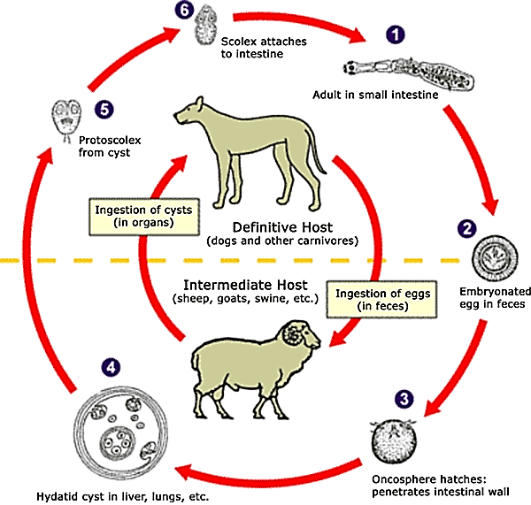
Life cycle
Picture 1: Life cycle (The Centers for Disease Control and Prevention Image Library, Global Health, Division of Parasitic Diseases and Malaria).

Slide 9
Morphology: cestode structure
Echinococcus granulosus – tapeworm.
Mature parasite (cestode) – small helminth up to 5 mm.
It сonsists of:
scolex (head), 4 suckers and a proboscis with small hooks;
neck;
3-5 segments:
immature;
hermaphroditic;
mature segment (proglottids) within the well developed uterus, containing around 800 mature eggs.

Slide 10

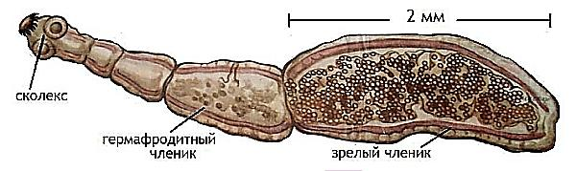
Morphology: cestode structure
Picture 2: Adult echinococcus. Light microscopy, hematoxylin-eosin stain.
Picture 3: Adult echinococcus (Echinococcosis Surgery / Yu.L. Shevchenko, F.G. Nazyrov - M.: Dynasty Publishing House, 2016. - 288 p.).

Slide 11
Morphology: eggs structure
The eggs of the parasite are spherical, up to 30-50 µm in size.
Oncospheres are covered with several shells (membranes), resistant to external adverse factors. In moist soil, they are able to remain viable for:
three weeks – at a temperature of 30°C;
about a month – at 10-20°C;
more than six months – at 6°C.
Under direct sunlight and in dry conditions, Echinococcus eggs can survive only for a short time period.

Slide 12
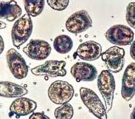
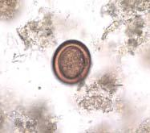
Morphology: eggs structure
Picture 4. Riped Echinococcus eggs. Light microscopy (Echinococcosis Surgery / Yu.L. Shevchenko, F.G. Nazyrov - M.: Dynasty Publishing House, 2016. - 288 p.).

Slide 13
Morphology: cyst structure
The wall of the cyst consists of 2 membranes:
internal – germinal (embryonic);
external – cuticular (chitinous).
The germinal membrane is the carrier of all vital functions of the parasite.
Consists of syncytial epithelial layers and is divided into three zones:
cambial (parietal);
zone of calcareous bodies (middle);
zone of brood capsules with emerging protoscoleces and young daughter cysts (acephalocysts).

Slide 14
Morphology: cyst structure
For a single-chamber echinococcus, the phenomenon of endogenous budding is typical, i.e. formation inside the maternal large cyst of one or more child blisters (acephalocysts).
Acephalocysts are much less sensitive to chemotherapy than protoscoleces. Their presence indicates a higher risk of postoperative recurrence.
When the maternal cyst is damaged, the germinal elements continue to develop with the formation of exogenous cysts. They develop from protoscoleces, that have invaded between the chitinous membrane and the fibrous capsule.
Exogenous cysts are rare !!!

Slide 15
Morphology: cyst structure
Chitin shell – polymer mucopolysaccharide, chemically similar to insect chitin.
Thickness is about 2 mm.
Properties:
provides the parasite with low molecular weight nutrients.
serves to protect it from the effects of protective factors on the part of the host.
The cavity of the echinococcal cyst is filled with a liquid, which is a secretion product of the germinal membrane. It contains the nutrients necessary for the parasite and its metabolic products. In its pure form liquid is very toxic to the organism of the intermediate host.

Slide 16
Morphology: cyst structure
Outside, the echinococcal cyst is surrounded by a dense fibrous capsule (pericyst), formed as a result of protective liver tissues reactions against the parasite.
Fibrous capsule properties:
it is an obligatory element of the echinococcal cyst of the liver, without it there are no echinococcal cysts in the liver.
it ensures the viability of the parasite, and its own structure depends on the stage of development of echinococcus.
it is not an impenetrable barrier for parasite embryos, and the latter can develop both in itself and outside it, in the liver tissue.

Slide 17
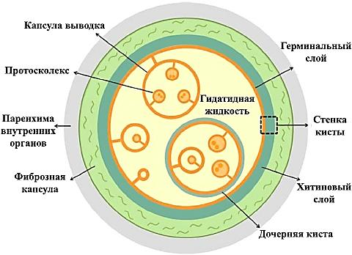
Morphology: cyst structure
Picture 5. Structure of an echinococcal cyst (https://thorax.com.ua/ru/drugie-zabolevaniya/4-3-ekhinokokkovye-porazheniya-ljogkikh-i-sredosteniya).

Slide 18
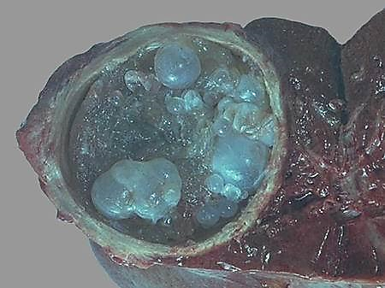
Morphology: cyst structure
Picture 6. Macropreparation. The cut surface of an echinococcal cyst (Diagnosis of the liver, biliary tract, pancreas, spleen and adrenal glands diseases / S.A. Panfilov - M.: Publishing House Binom «Knowledge Laboratory», 2003. - 215 p.).

Slide 19
Life stages of echinococcal cyst
There are 3 periods of vital activity of the parasitic cysts:
«living parasite» – cuticular shell is well expressed, its structure is not changed, child blisters are absent. Cyst contains clear liquid.
«dead parasite»:
early posthumous changes are characterized by the appearance in the cyst of child blisters. Cuticular shell retains its structure, the germinal layer can peel off, liquid remains transparent.

Slide 20
Life stages of echinococcal cyst
late posthumous changes are characterized by the destruction of cuticular shells and degenerative changes are observed in subsidiaries cyst. The cystic fluid turns into putty-like mass. In fibrous capsule calcifications appear.
III. «complicated cyst» – characterized by cyst suppuration, calcification, possible breakouts in the free abdominal cavity and organs, into the pleural cavity, bronchus, bile ducts, etc.

Slide 21
Echinococcosis classification
According to the principle of infection:
primary echinococcosis;
residual echinococcosis;
recurrent echinococcosis.
According to the volume of parasitic invasion:
solitary – single cyst in one organ or tissue of the same anatomical areas;
multiple – multiple cysts in one organ or several organs of one anatomical areas;
combined – multiple cysts in organs and tissues of various anatomical areas;
disseminated (generalized) – echinococcosis in pleural cavity, abdominal cavities, etc.

Slide 22
Echinococcosis classification
By echinococcal cysts size :
small cysts (less than 5 cm);
medium cysts (5-10 cm);
large cysts (more than 10 cm).
By quantity in chambers:
single-chamber echinococcosis;
multi-chamber echinococcosis.
By localization in liver:
sub-capsular echinococcosis;
sub-phrenic echinococcosis;
central (intraorganic) echinococcosis.

Slide 23
Echinococcosis classification
According to the clinical course,
they are distinguished in three stages:
latent (early) stage – from the moment of infection to the appearance of first clinical signs of the disease;
clinical stage (the stage of the formed cysts) – characterized by pronounced clinical manifestations, driven by growth and development of the parasite
complicated (terminal) stage – as a result of compression of organs and tissues, it is most pronounced after the death of the parasite and suppuration of the cyst.

Slide 24
Clinic of liver echinococcosis
Clinical manifestations vary depending on the stage of the disease.
Latent stage:
there are no specific symptoms;
non-specific symptoms:
anorexia, weight loss, weakness, diarrhea (as a result of chronic intoxication with parasite metabolic products);
recurrent urticaria, pruritus (as a result of sensitization parasitic fluid proteins).

Slide 25
Clinic of liver echinococcosis
Clinical stage:
Characteristic of symptoms is determined by the localization, size, multiplicity of invasion, the rate of cyst growth, the mechanical and toxic effects of the parasite, as well as the reactivity of the host organism.
In the clinical stage of liver echinococcosis, 2 groups of syndromes can be distinguished:
local – due to mechanical compression of organs or tissues due to cyst growth;
common – due to the toxic-allergic influence of the parasite.

Slide 26
Clinic of liver echinococcosis
Local manifestations of the disease:
pain syndrome (80%) – heaviness, dull and aching pain in the right hypochondrium, epigastric region. When the cyst is localized in the right lobe of the liver, the pain syndrome may resemble cholecystitis or hepatic colic;
dyspeptic syndrome – with the localization of the cyst in the left lobe of the liver – heartburn, belching, vomiting.
General syndromes of the disease:
anorexic syndrome – lack of appetite and weight loss;
dyspeptic syndrome – nausea, vomiting, diarrhea;
toxic allergic syndrome – febrile and subfebrile temperature, chills, weakness, dizziness, allergic manifestations.

Slide 27
Clinic of liver echinococcosis
Complicated stage:
Complications can be divided into 2 groups (according to the classification of I.N. Madaliev):
Acute:
1) the death of the parasite with suppuration of the cyst and the formation of a liver abscess;
2) rupture of an echinococcal cyst with the breakthrough of the contents into:
free abdominal cavity – with the peritoneal and a board-shaped abdomen;
pleural cavity – with the formation of pleurisy and pleural empyema;
in the pericardium (rarely) – collapse, shock, rapid death;

Slide 28
Clinic of liver echinococcosis
gallbladder – with a blockage of the cystic duct and the occurrence of acute stoneless cholecystitis;
bile ducts – with the cholangitis clinic and obstructive jaundice;
retroperitoneal space – with the formation of abscesses or phlegmon of retroperitoneal tissue.
3) eosinophilic acute cholecystitis.
NB! The cyst that will rupture into the cavity will have typical picture of toxic-anaphylactic shock with relevant clinical manifestations.
Rupture of a cyst in the pericardium – the probability of death is close to 100%.

Slide 29
Clinic of liver echinococcosis
Complicated stage:
II. Chronically progressive:
1) General:
obstructive jaundice syndrome – with compression of extra- and intrahepatic bile ducts;
portal hypertension syndrome – with localization in the gate of liver with compression of the portal vein branches / or as a result of cirrhosis of the liver;
vena cava inferior compression syndrome;
toxic-allergic syndrome.
2) Local:
cirrhosis and amyloidosis of the liver (with manifestations of liver failure).

Slide 30
Diagnostics
I. General clinical methods of research:
analysis of complaints;
collection of anamnesis;
objective examination.
II. Laboratory diagnostics:
clinical detailed blood test – eosinophilia, increase in ESR;
biochemical blood test – to assess the functional state of the liver.

Slide 31
Diagnostics
3) Serological reactions to echinococcosis:
skin-allergic method test by Katsoni;
reaction to latex agglutination (RLA) by V.I. Zorikhina;
reaction to indirect hemagglutination (RIHA) by A.P. Stepankovskaya;
reaction to double diffusion in gel (DDG) by A.I. Gusev and V.S. Tsvetkov;
reaction to enzyme immunoassay (RIFA) by V.I. Zorikhina.

Slide 32
Diagnostics
III. Instrumental diagnostics:
ultrasound diagnostics;
radiography and fluoroscopy;
CT-scan;
MRI-scan;
radioisotope research;
selective angiography;
laparoscopy.

Slide 33
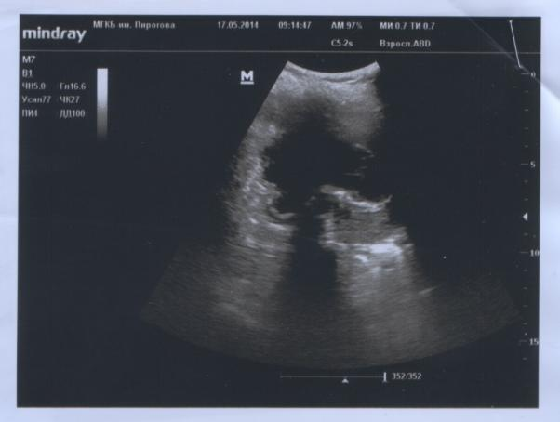
Diagnostics
Picture 7. Ultrasound diagnostics. Patient K., 64 years old. Echinococcal single-chamber cyst of the liver right lobe (photo of own observation).

Slide 34
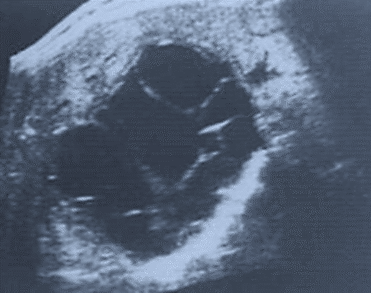
Diagnostics
Picture 8. Ultrasound diagnostics. Echinococcus multilocular cyst (Diagnosis of the liver, biliary tract, pancreas, spleen and adrenal glands diseases / S.A. Panfilov – M.: Publishing House Binom «Knowledge Laboratory», 2003. - 215 p.).

Slide 35
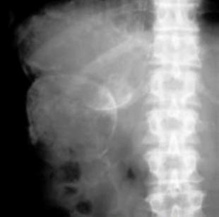
Diagnostics
Picture 9. Abdominal X-ray. Echinococcal cyst of the liver right lobe (Echinococcosis Surgery / Yu.L. Shevchenko, F.G. Nazyrov - M.: Dynasty Publishing House, 2016. - 288 p.).

Slide 36
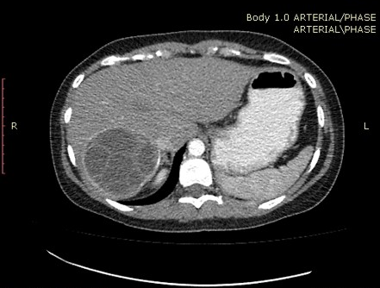
Diagnostics
Picture 10. Computed tomography (axial section). Echinococcal single-chamber cyst of the liver right lobe (photo of own observation).

Slide 37
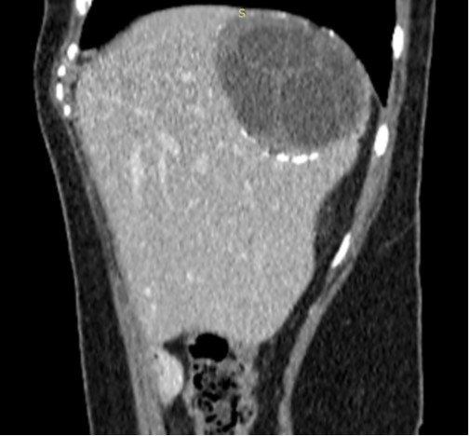
Diagnostics
Picture 11. Computed tomography (sagittal section). Echinococcal single-chamber cyst of the liver right lobe (photo of own observation).

Slide 38
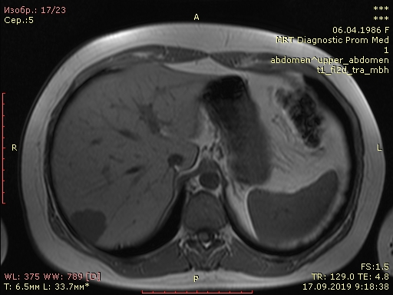
Diagnostics
Picture 12. Magnetic resonance imaging (axial section). Echinococcal single-chamber cyst of the liver right lobe (photo of own observation).

Slide 39
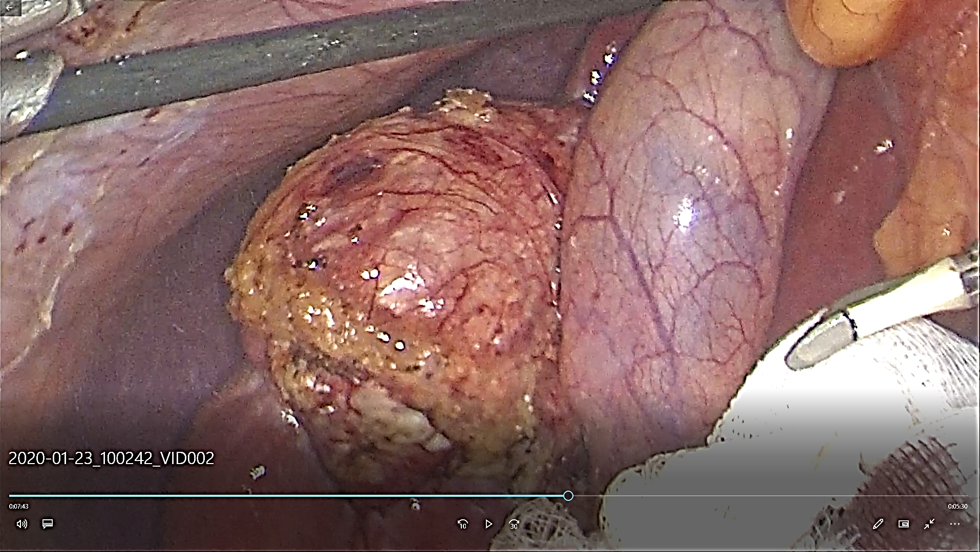
Diagnostics
Picture 13. Laparoscopic visualization of an echinococcal cyst (photo of our own observation).

Slide 40
Differential diagnosis
Differential diagnosis of echinococcal cysts is carried out with such focal liver formations as:
non-parasitic liver cysts;
polycystic disease of liver;
liver abscesses;
biliary hamartoma;
hemangioma of liver;
hepatocellular adenoma of liver.
It is also necessary to differentiate with another form of parasitic invasion – alveolar echinococcosis.

Slide 41
Conservative treatment
Conservative treatment is reduced to use various chemotherapeutic drugs aimed to parasite killing.
Applied mebendazole (Vermox) and albendazole (Zentel). It cause irreversible morphological changes in cuticular shell – rejection of the germinative layer with its subsequent degeneration.
Main indications:
intraoperative detection of very small cysts dissemination in the abdominal cavity (with intraabdominal rupture echinococcal cysts);
prevention of disease relapse.
Chemotherapy is appointed immediately after surgery and continued after patient discharging from surgical hospital.

Slide 42
Surgical treatment
In surgery of liver echinococcosis observance of the aparasitism and antiparasitism principles is a required condition.
The principle of aparasitism is a set of measures taken before and during surgery to prevent dissemination and implantation of germinal elements of the parasite, preventing relapses and generalization of the diseases.
The principle of antiparasiticity is a set of measures taken before and during the operation in order to neutralize the germinal elements of the parasite.

Slide 43
Surgical treatment
Components of aparasitism:
accurate topical diagnosis of cyst localization;
rational operational access;
careful delimitation from cysts of surrounding tissues;
minimization of cysts traumatization during the operation;
it is not allowed to get cystic fluid on the operated organ during open echinococcectomy, contamination of the surgical wound and surgical linen in order to prevent dissemination;
complete removal of germ line elements and cuticular membranes to prevent recurrence of diseases;
resolving the issue in favor of closed echinococcectomy.

Slide 44
Surgical treatment
Components of antiparasitism:
preoperative chemotherapy;
neutralization of parasite germinal elements in the maternal cyst and residual cavity by exposure to chemical drugs and physical factors;
sanitation of the contaminated abdominal cavity with chemical drugs and physical factors;
postoperative chemotherapy.

Slide 45
Surgical treatment: surgical access
Operative accessment to the echinococcal cyst are divided into:
traditional (laparotomy);
miniinvasive:
puncture;
video-endoscopic.
Traditional surgical accesses:
localization of cysts in the area of liver gates, visceral surface of liver, in I, II, III, IV, V segments – applied upper medial laparotomy;
In VI, VII – applied right-handed infracostal access;
in VII, VIII – applied right-handed thoraco-phreno-laparotomy.

Slide 46
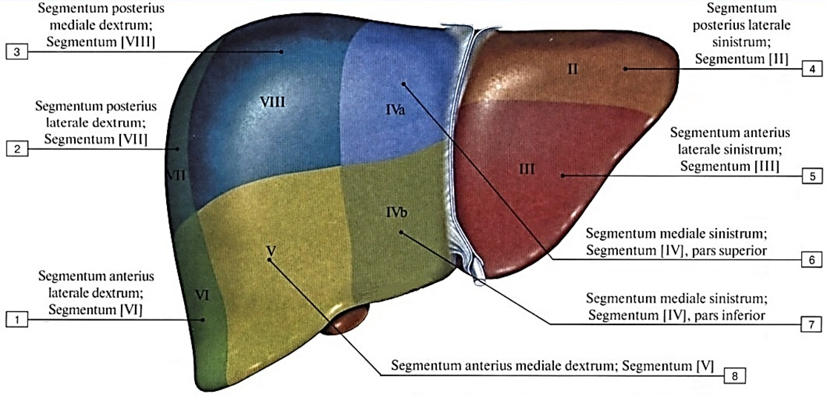
Segments and lobes of liver
Picture 14. Segments projection to the liver diaphragmatic surface (Atlas of human anatomy in 4 volumes. Vol. 2: textbook for medical universities / R.D. Sinelnikov, Ya.R. Sinelnikov, A.Ya. Sinelnikov - M.: Publishing house "New wave", 2010. - 248 p.).

Slide 47
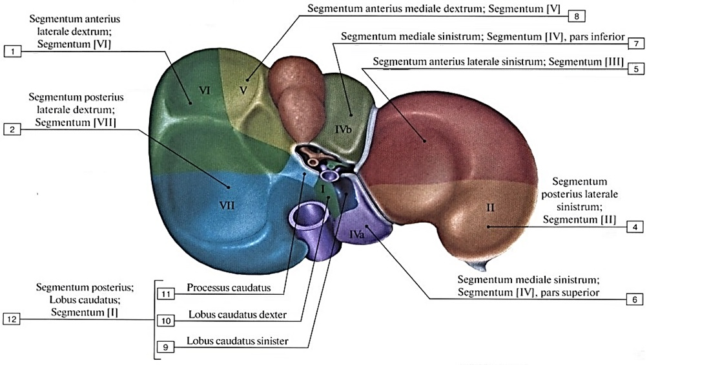
Segments and lobes of liver
Picture 15. Segments projection to the liver visceral surface (Atlas of human anatomy in 4 volumes. Vol. 2: textbook for medical universities / R.D. Sinelnikov, Ya.R. Sinelnikov, A.Ya. Sinelnikov - M.: Publishing house "New wave", 2010. - 248 p.).

Slide 48
Puncture method
  is performed under ultrasound or CT-control;
  the procedure is performed under local anesthesia;
  surgeon puncture the cyst and remove 20 ml of liquid;
  rapid analysis of fluid for the presence of scolex;
  introduction into the cavity of 20 ml of a 20-30% NaCl solution and then aspiration of 20 ml of cyst fluid (multiple repetition of manipulation within 10-15 minutes);
  replacing the needle with a stylet catheter, evacuating the remaining fluid;
  2-3 weeks 20-30% of NaCl is injected into the cyst and scoleces died (drainage channel is formed around the plastic drainage);
  using a vacuum extractor, elements of the chitinous shell are removed through the drainage channel;
  upon receipt of a clear liquid (without scoleces and a chitinous membrane), the drainage from the cyst is removed.

Slide 49
Laparoscopic echinococcectomy
Indications: uncomplicated small cysts without obvious signs of the child blisters presence, located on the visceral surface of the liver.
Assisted laparoscopic echinococcectomy – combination of laparoscopy and open surgical intervention – during survey laparoscopy liver revision is performed and minilaparotomy (up to 6 cm long) in the projection of the identified cyst is applied for traditional echinococcectomy.
Laparoscopically assisted open echinococcectomy – after open echinococcectomy endovideoscopy applied for residual cavity rehabilitation and elimination of biliary fistulas.

Slide 50
Laparoscopic echinococcectomy
Advantages of laparoscopic operations:
minimal injury;
possibility of 2 or more cysts removing without expansion (especially with damage to both shares);
possibility of detailed examination of the fibrous capsule cavity and removing of the chitin shells remnants.
Disadvantages of laparoscopic operations:
higher risk of abdominal cavity dissemination;
absence of disinfection effective methods;
complexity of residual cavities elimination.

Slide 51
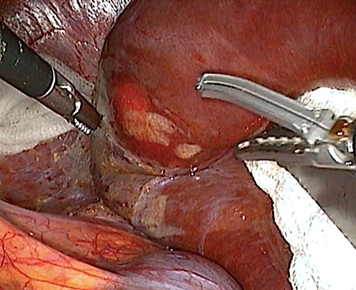
Laparoscopic echinococcectomy
Picture 16. The process of echinococcal cyst isolation (photo of our own observation).

Slide 52
Echinococcectomy methods
The operation consists of 2 stages:
echinococcectomy (removal of the parasite);
liquidation of residual cavity.
Ways of echinococcectomy:
1) closed echinococcectomy – without opening of the cyst cavity:
«perfect» echinococcectomy – removal of the cyst without opening of chitinous shells;
cystpericistectomy – removal of cysts with fibrous capsule;
resection of the liver part with cyst (typical and atypical);
2) open – with puncture and opening the cyst and removal its content;
3) combined – with multiple echinococcosis – combination of closed and open removal of cysts.

Slide 53
Technique of «perfect» echinococcectomy
Implementation of surgical access.
Delimitation of the cyst in accordance with the principles of aparasitism and antiparasitism.
Puncture of the cyst to relieve tension.
Evacuation of the cyst contents by electric suction.
Removal of the cyst (the cyst is opened wide, the chitinous membrane is grasped with a terminal clamp, peeled off from the fibrous capsule and removed).
Antiparasitic treatment of the residual cavity (the remaining fibrous capsule is treated with a 2-5% solution of formaldehyde in glycerin).
Elimination of the residual cavity.
Suturing of the postoperative wound.

Slide 54
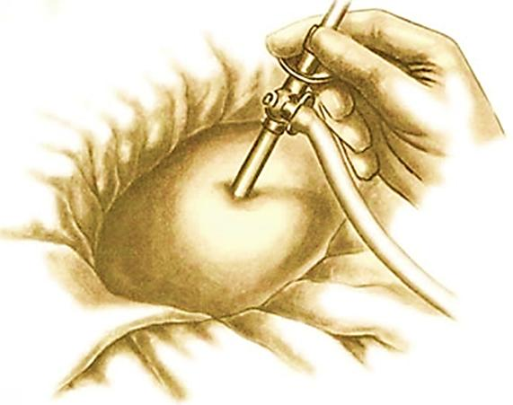
Technique of «perfect» echinococcectomy
Picture 17. Cyst puncture with evacuation of contents by electric suction (Atlas of operations on the abdominal wall and abdominal organs / V.N. Voilenko, A.I. Medelyan, V.M. Omelchenko. - M.: Medicine, 1965. - 606 p.).

Slide 55
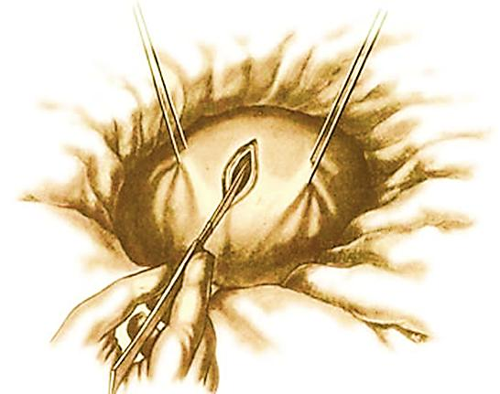
Technique of «perfect» echinococcectomy
Picture 18. Opening of the fibrous capsule (Atlas of operations on the abdominal wall and abdominal organs / V.N. Voilenko, A.I. Medelyan, V.M. Omelchenko. - M.: Medicine, 1965. - 606 p.).

Slide 56
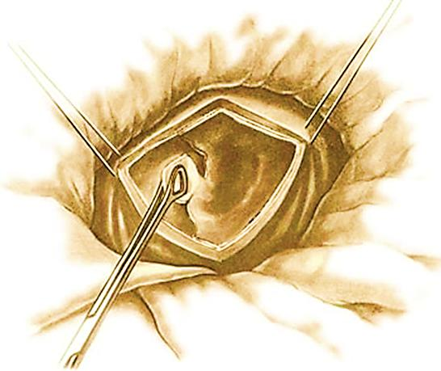
Technique of «perfect» echinococcectomy
Picture 19. Parasite removal with a chitinous membrane (Atlas of operations on the abdominal wall and abdominal organs / V.N. Voilenko, A.I. Medelyan, V.M. Omelchenko. - M.: Medicine, 1965. - 606 p.).

Slide 57
Methods of residual cavity eliminating
I. Complete elimination of residual cavity:
capitonage (suturing of residual cavity);
intussusception of fibrous capsule;
omental tamponade (omentoplasty);
aplatization (subtotal resection of the capsule);
pericystectomy (total resection of the capsule);
combined method.
II. Incomplete elimination of residual cavity (after capitonage, intussusception, omental tamponade, etc.) with external drainage.

Slide 58
Methods of residual cavity eliminating
III. External drainage of residual cavity:
through transhepatic drainage;
terminal drainage;
drainage assesment to prevent suppuration of the residual cavities;
insubsequently performed fistulography, for control healing.
3) marsupilization.
IV. Internal drainage of residual cavity – cysto-digestive anastomoses.

Slide 59
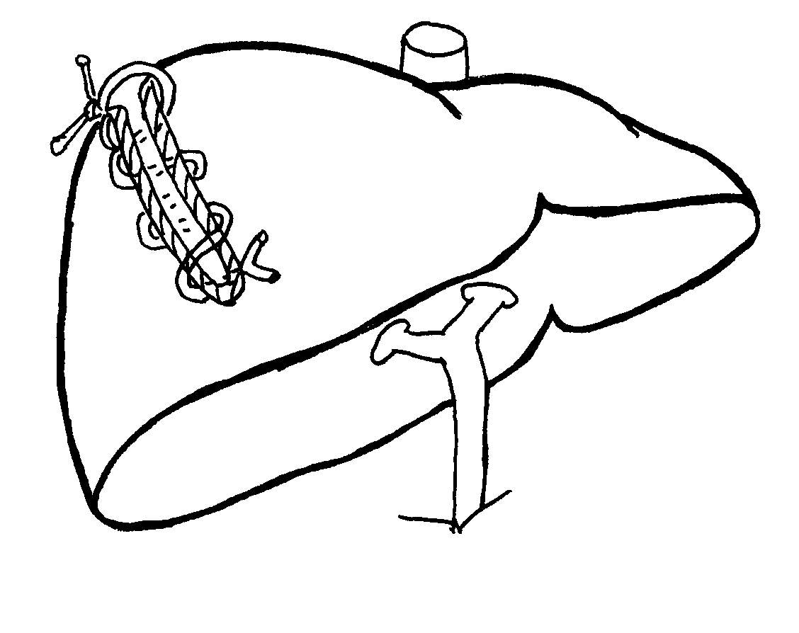
Methods of residual cavity eliminating
Capitonnage – with separate U-shaped (purse-string) sutures from the inside, the walls of the cyst are brought together until their full contact.
The walls are not stitched through the entire thickness of the fibrous capsule in order to avoid vessels and bile ducts damage.
Picture 20. Capitonnage (scheme from open sources of the Internet).

Slide 60
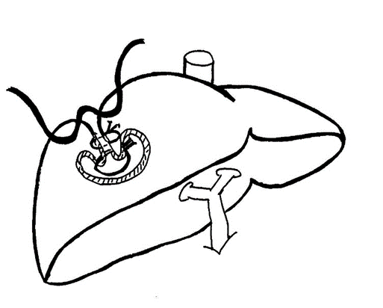
Methods of residual cavity eliminating
Invagination of the fibrous capsule inside allows to eliminate the residual cavity of complex shape.
Applicable for multiple lesions or in the case of large vessels and bile ducts anatomical proximity.
Picture 21. Invagination (scheme from open sources of the Internet).

Slide 61
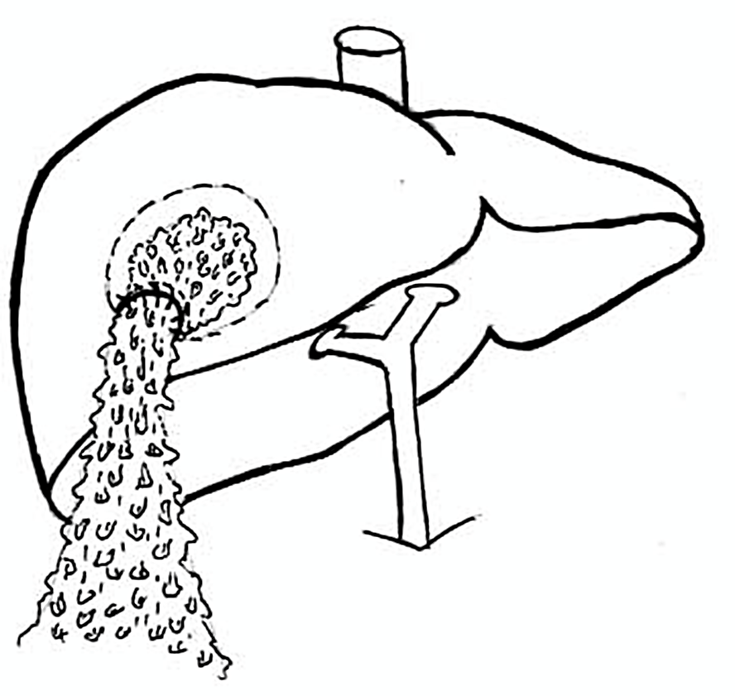
Methods of residual cavity eliminating
Omental tamponade – a mobile area of ​​the large omentum is brought and spread over the inner surface of the fibrous capsule, fixing it to it with separate sutures.
The technique is easy to perform, has good postoperative results.
Picture 22. Omental tamponade (scheme from open sources of the Internet).

Slide 62
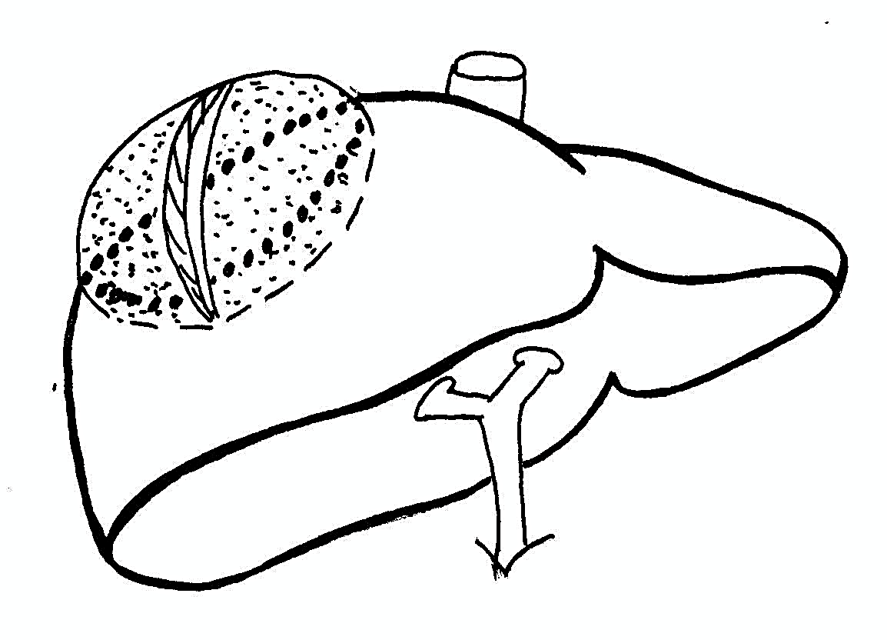
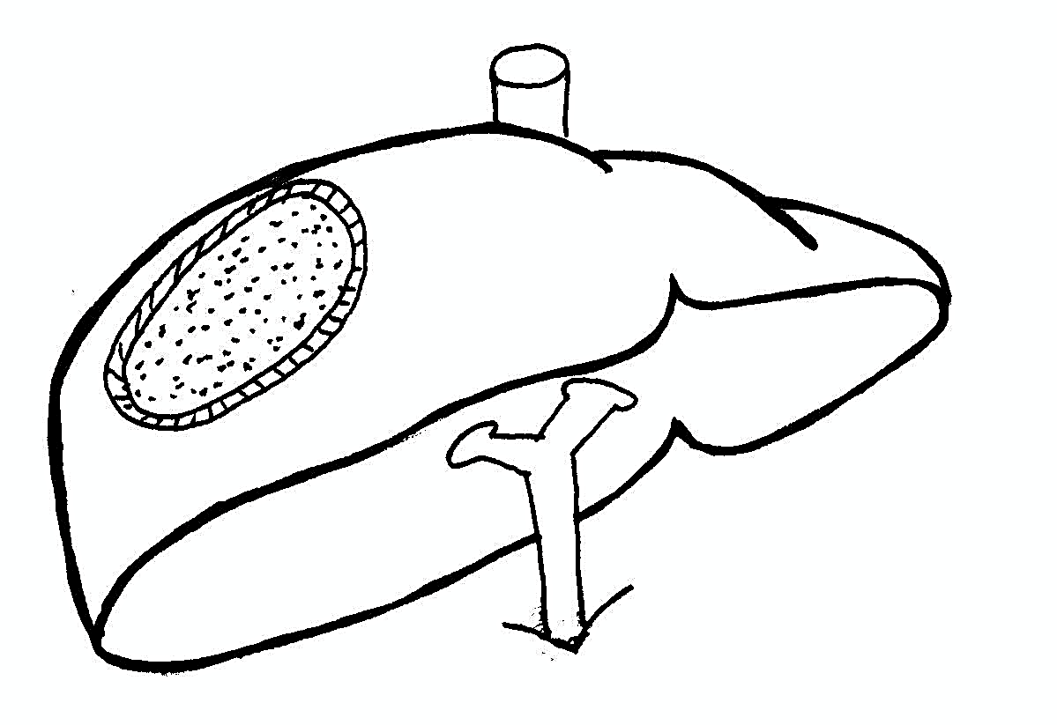
Methods of residual cavity eliminating
Aplatization (abdominization) – subtotal resection of the fibrous capsule – is used for superficially located cysts.
Picture 23. Aplatization (scheme from open sources of the Internet).

Slide 63
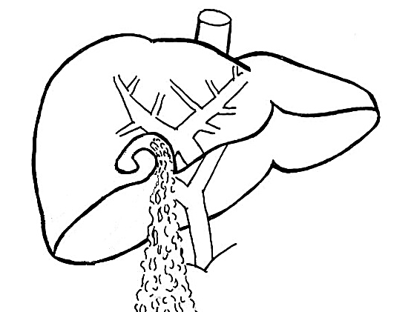
Methods of residual cavity eliminating
Combined method – combination of methods.
Picture 24. Invagination and omentoplasty (scheme from open sources of the Internet).

Slide 64
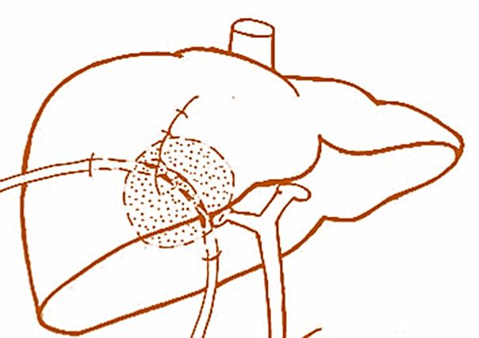
Methods of residual cavity eliminating
The technique of through transhepatic drainage.
Picture 25. Through transhepatic drainage (scheme from open sources of the Internet).

Slide 65

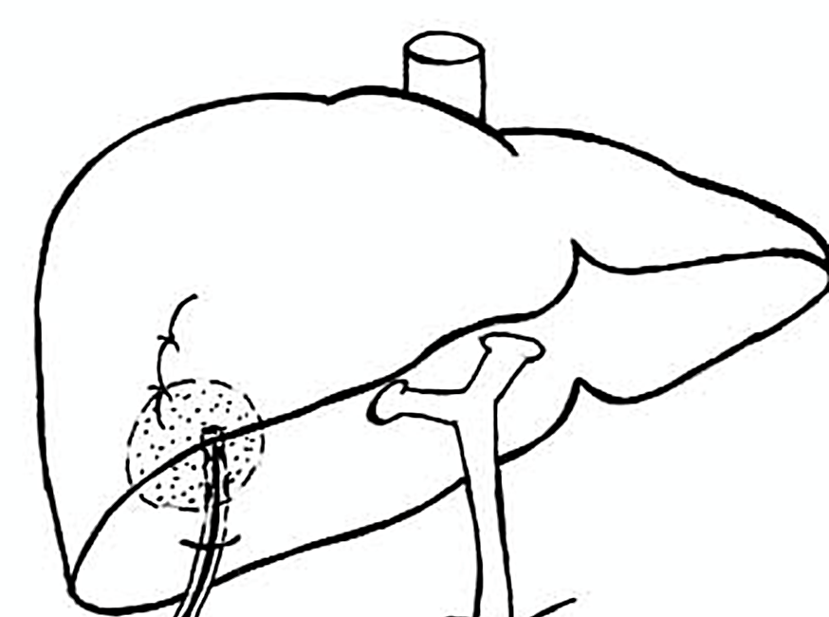
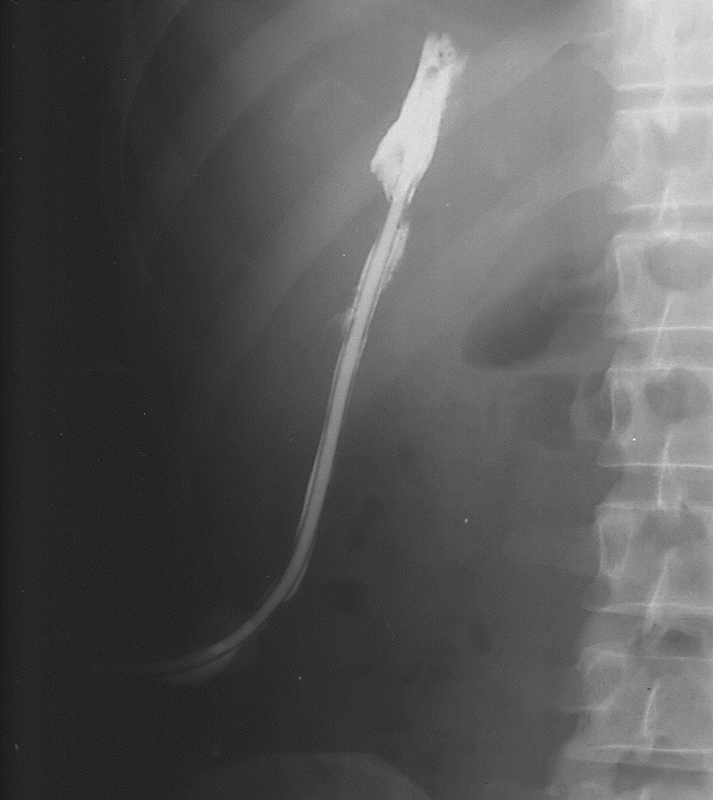
Methods of residual cavity eliminating
The technique of terminal drainage.
Picture 26. Terminal drainage (scheme from open sources of the Internet).
Picture 27. Fistulography - residual cavity (photo of own observation).

Slide 66
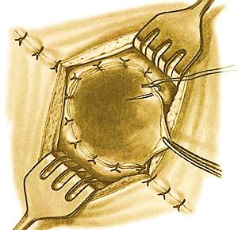
Methods of residual cavity eliminating
Marsupilization – suturing the fibrous capsule edges to the parietal peritoneum.
Picture 28. Marsupilization (Atlas of operations on the abdominal wall and abdominal organs / V.N. Voilenko, A.I. Medelyan, V.M. Omelchenko. - M.: Medicine, 1965. - 606 p.).

Slide 67
Methods of residual cavity eliminating
Internal drainage of the residual cavity:
cystoenteroanastomosis – stitching of the residual cavity with the jejunum, «turned off» by Ru;
cystogastroanastomosis – stitching of the residual cavity with the stomach through a tube formed from its wall.
Operations like this are rare!
The only one indication is copious bile leakage from the cavity of the cyst (at the same time, the main bile ducts are freely passable).

Slide 68
Alveococcosis of liver
Differential signs | Echinococcosis | Alveococcosis
1. Pathogen | Echinococcus granulosus | Echinococcus multilocularis
2. The structure of the cyst | Fluid-filled bladder with scolex, 2 membranes | Conglomerate of small bubbles connected by connective tissue, scoleces are not always present
3. Fibrous capsule | Fibrous capsule is a mandatory element | Fibrous capsule is not expressed - fails to form
4. Type of growth | Expansive | Infiltrative (similar to a malignant tumor)
5. Growth rate | Slow | Relatively fast

Slide 69
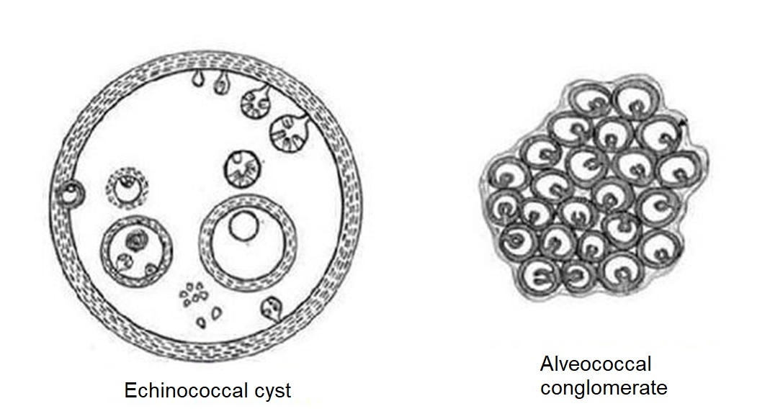
Alveococcosis of liver
Picture 29. The difference between echinococcus and alveococcus cystic forms (scheme from open sources of the Internet).

Slide 70
Alveococcosis of liver
Differential signs | Echinococcosis | Alveococcosis
6. Length of mature parasite | 2,7 – 5,4 mm | 2,3 – 3,2 mm
7. Intermediate hosts | large and small horned livestock, deer, elk, pigs, wild boars, kangaroos, camels, humans | wild mouse rodents, human
8. Target Organs | 70% - liver. Can be localized in all human tissues and organs | 97% - liver. Rarely affects other organs
9. Status of the liver on examination | Consistency of liver in objective examination is not changed. The surface is smooth, the contour is even | On palpation, the liver has stone consistency. Surface uneven, bumpy

Slide 71
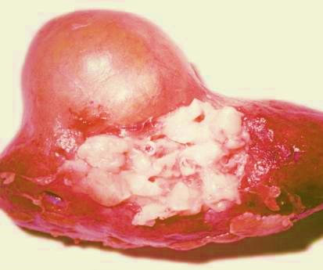
Alveococcosis of liver
Figure 30. Makropreparation. Alveococcosis of liver (photo of own observation).

Slide 72
Alveococcosis of liver
Differential signs | Echinococcosis | Alveococcosis
10. Probability of metastasis | Low | High
11. Features of the clinical picture | 3 clinical stages | The stages are the same. Long asymptomatic period. Stage 1 quickly passes to stage 3
12. Features of ultrasound and CT imaging | Has clear contours. Layering of the wall, detritus-like content | Looks like malignant tumor with uneven fuzzy contours (like a «grapes bunch»)

Slide 73
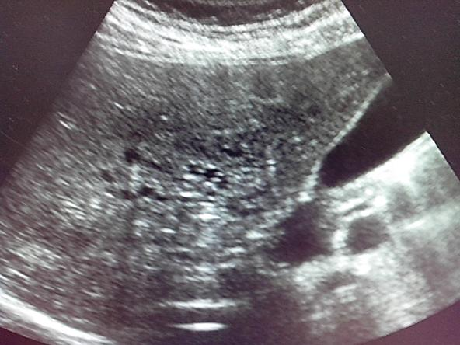
Alveococcosis of liver
Figure 31. Ultrasound investigation. Alveococcus invades the vena cava inferior (http://www.echinococcus.ru/alveokokk-pecheni).

Slide 74
Alveococcosis of liver
Differential signs | Echinococcosis | Alveococcosis
13. Features of post-mortem changes | Characterized by calcification or suppuration of the cyst | Characterized by the collapse of the «tumor»
14. Features of calcification | The cyst is calcified always only on the periphery (fibrous capsule) | Characterized by the presence of many petrificates in the center, and on the periphery
15. Opportunities for surgical care | Mostly radicalsurgical interventions | Mostly palliative surgery
16. Lethality | 2 - 4% (A.V. Zhao, 2016) | 15 - 38% (B.I. Alperovich, 2011)

Slide 75
Recommended literature
Echinococcosis surgery / Yu.L. Shevchenko, F.G. Nazyrov - M .: Dynasty Publishing House, 2016. - 288 p.
Surgical diseases: textbook / ed. M.I. Cousin. - 4th ed., revised. and additional - M.: GEOTAR-Media, 2014. - 992 p.
Surgical diseases. In 2 volumes. Volume 1: textbook / ed. V.S. Savelyeva, A.I. Kiriyenko. - 2nd ed., revised. and additional - M.: GEOTAR-Media, 2017. - 720 p.
Guidelines for surgery of the liver and biliary tract. Volume 1/ed. A.E. Borisov - St. Petersburg: EFA Enterprise, 2002. - 448 p.
Liver surgery / B.I. Alperovich - M.: GEOTAR-Media, 2013. - 352 p.
All shown images is borrowed from public Internet resources, which do not contain any indication of the authors of these materials and any restrictions on their borrowing.

